Slide 1

NTT DATA Capabilities for SRE

Slide 2
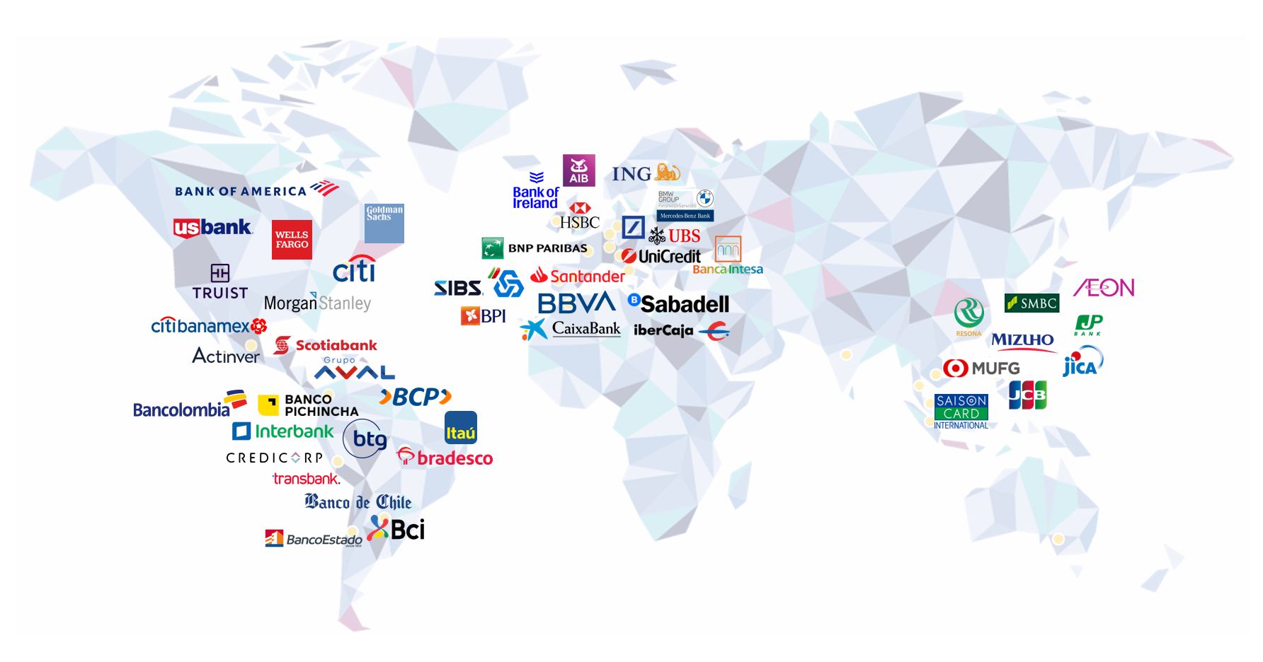




About NTT DATA: We are a Trusted Global Services Provider
We are part of
the NTT Group
~$100B
$3.6B+
150+
75%
#83
A
330K+
Annual revenue
in annual R&D investment
years in business
of Fortune Global 100 are our clients
Ranked in Fortune Global 500
Credit rating from S&P Global
Professionals employed
NTT DATA, Inc.
size and scale
$30B+
50+
29
6th
3rd
5th
195K+
Annual revenue
($8.3bn in FSI –
2nd in Market Share²)
Regions and countries worldwide
countries NTT DATA is rated a top employer
Most valuable IT Services Brand¹
Largest data center provider in the world
Largest global IT
services provider
Professionals employed
End-to-End, Full Stack, Global Capability to Transform and Operate at Scale
Balanced Global Delivery within Financial Services
Cross-Segment Expertise: Bank Modernization, Digital Transformation, Core Banking, Lending, Cards and Payments, Customer Experience and Engagement​, Customer Onboarding, Branch Operations, CRM, Treasury, Document Management​, Risk Management and Compliance​, Workforce Readiness, Wealth Management
Deep Financial Services Experience – 50,000+ SMEs serving top global financial institutions
Run 200+ Tier-3 Data Centers; ~40% of all internet traffic flows through NTT DATA’s managed global infrastructure
Strong Partnerships & Experience –with platforms including Flexcube, Thought Machine, Temenos, 10x, Mambu, Tuum, nCino, Fiserv, Finastra, FIS, RedHat & more…
AWS (Premier Partner), Google (Premier Partner), Azure (Microsoft GSI), Salesforce (Summit Partner) run in our data centers
Not exhaustive
Recognized as Leading in the Market
“Leader” in Everest Group’s Open Finance IT Services PEAK Matrix Assessment, 2024
“Leader” in Everest Group’s Payments IT Services PEAK Matrix Assessment, 2024
“Leader” in Digital Workplace Services in Everest Group’s PEAK Matrix® – Jan 2024
”NTT DATA is a good fit for transformational deals” - Gartner Magic Quadrant for Data Center Outsourcing and Hybrid Infrastructure Managed Services, 2022
“Leader” in the 2024 Gartner Magic Quadrant for Outsourced Digital Workplace Services
NTT ranked as one of the BCG “Top 50 most innovative companies on this planet,” BCG, May 2024
“An Overall Leader” in Nelson Hall’s NEAT Evaluation of End-to-End Cloud Infrastructure Management Services - July 2022
© 2024 NTT DATA Inc.
Notes:
We are a 30 billion dollars, invisible company that is changing the world but doing so responsibly
A top 5 IT services provider
We spend 30% of our profits on innovation and sustainability as NTT group

Slide 3












We are the World’s only Full Stack Transformation Company
Maximize the Mix of Humans & Machines
To Increase Revenue, Decrease Cost and Risk
We Operate at
Global Scale and Scope
5th
Largest Global IT Service Provider
Connect Executive North Stars
to “Just Enough” Advisory & Strategy
$30B+
(50+ Countries, 195k Employees)
Annual Revenue
Create Frictionless Experiences
2nd
Largest Banking IT Service Provider
Systems
Integrator
Mine and Automate Processes
2nd
Largest Managed Service Provider
Platform
Transformer
Infuse AI & Super Intelligence
Run, Transform and Build Apps
$3.5B+
Annual Spend on innovation & sustainability (30% profits reinvested)
Modernize from Edge-to-Core
with Unique Hybrid Colo Multi-Cloud
29
Countries rated top Employer in
Connect Everything Using the Most
Advanced Wireless and Wired Networks
Lead with innovation and assets
© 2024 NTT DATA Inc.
3
Notes:
I won't spend a lot of time, but I will make the bold claim that we are: The world's only Full stack Transformation Company. There is no company on the planet that can match what we can do.
With our unique assets and capabilities, we offer our clients with a mix of humans and machines that drives real business outcomes from them, whether it's revenue increase, profit increase or risk minimization.
Create frictionless experiences for our clients, whether it's for their customers or their employees or their partners. - Standard Chartered: Shrinking Customer Base, Shrinking customer base, un-wieldy rewards engine, Need to increase market growth by implementing 3600 view of Customer - focused Loyalty Program- We implemented enterprise-wide Loyalty Implementation
Automate, process reengineering – WATCH
We have carved out our own centralised AI-Gen AI CoE, we added Model as a service
We provide end to end services - Goldman Sachs: We replatformed the World’s 2nd Largest Investment Bank to AWS (3x More Scale), Reduced TCO ~39% on their 7yr Mainframe cost
We run salesforce for salesforce. We're managing salesforce -Entire internal environment. And we're building all of the new applications for them. Vlocity & nCino are banking platforms that are run on Salesforce. – 650+folks working on Salesforce
We own our data centres

Slide 4













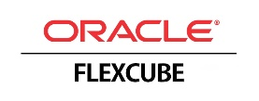












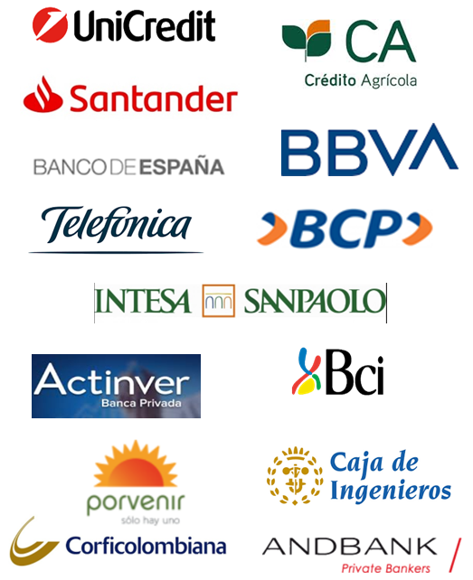



















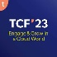

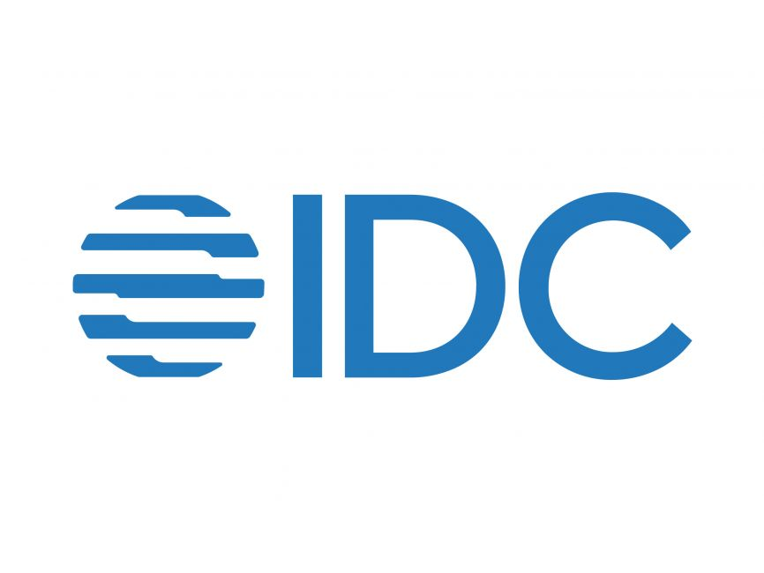











NTT DATA is recognised globally as a leading IT Service Provider to the Banking & Financial Services sector
#5
#2
75%
Trusted
Top 5 IT Service Providers in the world
NTT DATA is a second largest IT service provider for banking industry
We serve 3 out of every 4 Fortune 100 companies
NTT DATA is a trusted partner to two thirds of Global Systemically Important Banks (GSIBs)
Partner Ecosystem
Financial Crime
Core Banking
Capital Markets
Leader in Everest BFS Risk and Compliance IT Services PEAK Matrix® Assessment 2023
“NTT DATA is a good fit for transformational deals”
- Gartner Magic Quadrant June 2022
NTT DATA serves 8 out of 10 Global Capital Market firms
Thought Leadership
Participation in industry forums
Collaboration with analyst groups
Our Experience
>50% GSIBs are serviced by NTT DATA
Payments & Cards
Credit & Mortgages
Leader in Everest Payments IT Services PEAK Matrix ® Assessment 2023
Leader for Third Consecutive Year for Advanced Digital Workplace Services
- NelsonHall's NEAT Report 2022
Developing and maintaining mission-critical payment systems for Europe’s largest payment processor.
Provider of nation-wide banking infrastructure in Japan for the past 50+ years, serving 92% of regional banks.
Led one of biggest banking mergers in the U.S. deploying 400+ NTT DATA resources, successfully delivering 200 critical merger-related projects and initiatives.
© 2024 NTT DATA Inc.
GSIBs: Global Systematically Important Banks
Notes:
A top 5 IT services provider, 2nd largest in BFS

Slide 5

SRE Capabilities
© 2024 NTT DATA Inc.

Slide 6
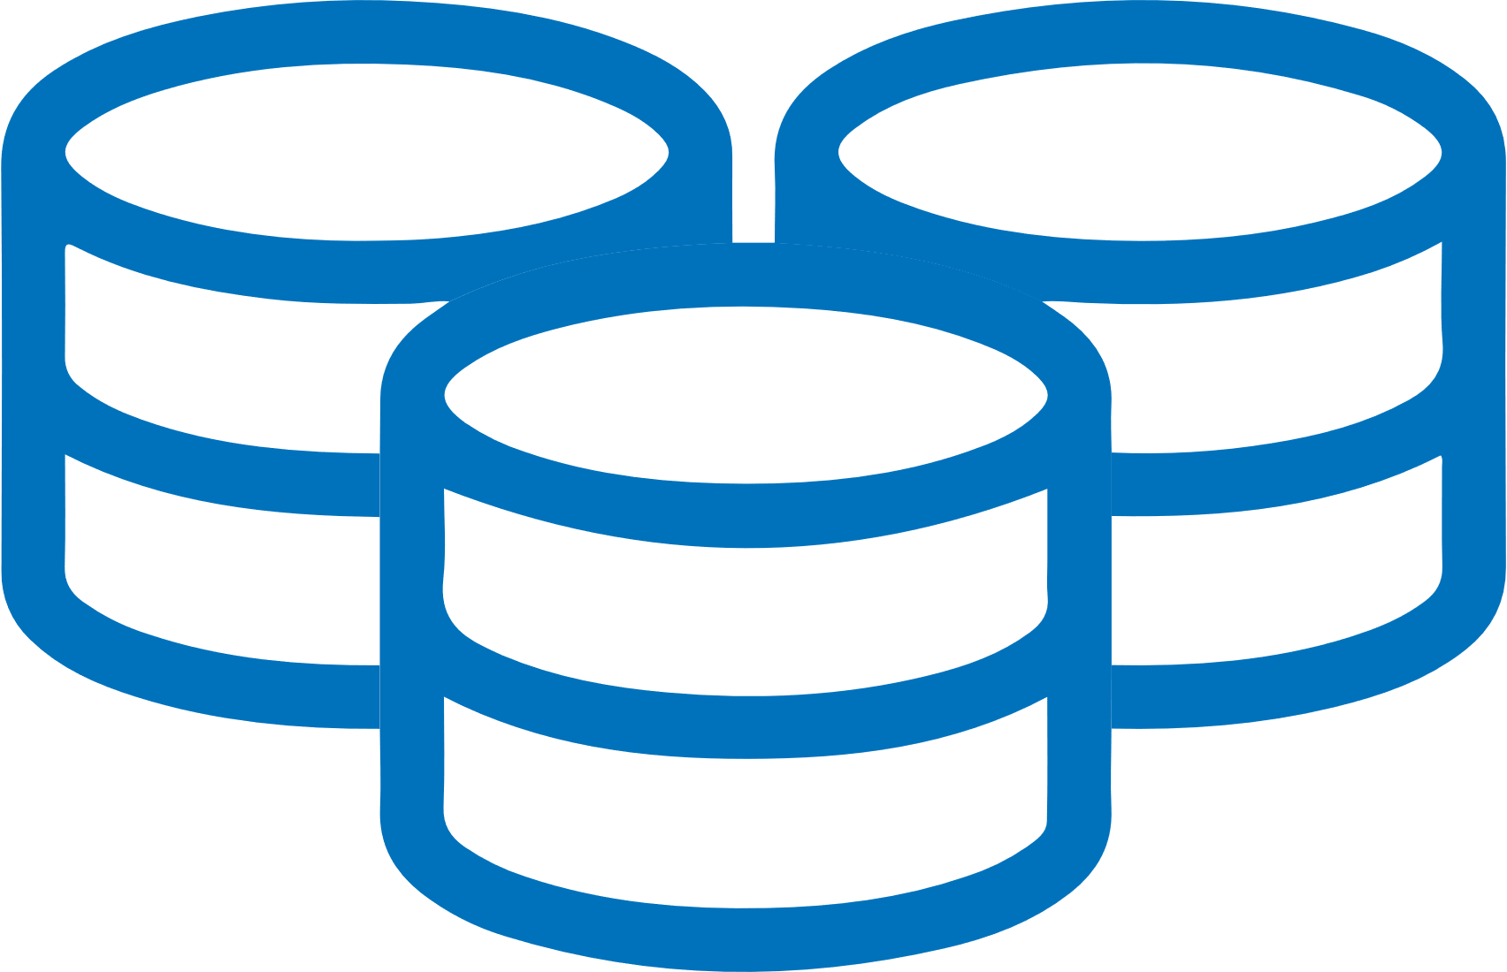



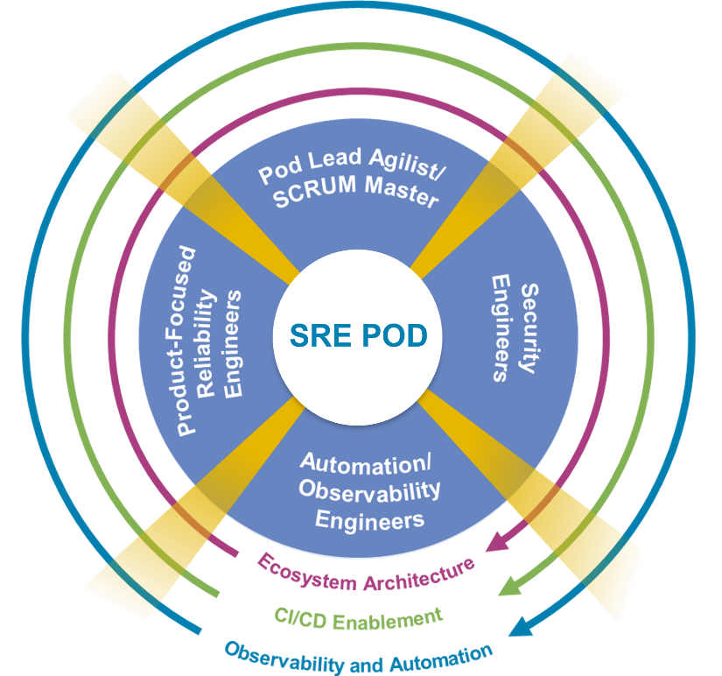
NTT DATA’s Approach to Transformation
Approach is to transform SRE operations through short-term, long-term initiatives and roadmap to have a target state where SRE is provided as a Service to bank consumers like business value streams and engineering.
Nascent State
Transformation State
Target State
Continuous improvement of SLI/SLO
SRE-as-a-Service with Continuous Improvement
Data silos
Manual repeated
task
Undefined
thresholds
SLI/SLO/SLA
Automation
Meaningful dashboards
Monitoring Tools
Enterprise Observability Automation
Feedback on SLO/SLI
Continuous improvement of AIOps
AIOps
AIOps platform for SRE Operations
Feedback on AIOps
Reactive
Proactive
Predictive
Enterprising
© 2024 NTT DATA Inc.
Notes:
Vikram
NTT DATA has a strong SRE practice supporting resiliency for organizations.
We follow a tool-agnostic approach and can help the organization in achieving the Target Operating Model where data is collated from all monitoring sources to be used in Dashboards and AIOps.
We help organizations transform SRE operations through short-term, long-term initiatives and a roadmap to have a target state where SRE is provided as a service to bank consumers like business value streams and engineering.
Defining and curating customized dashboards related to SLOs and Error Budgets.
We have been supporting various banks globally in the geographies of Europe, Ireland and US.
NTT DATA’s Splunk Capabilities are being powered by our Splunk Centre of Excellence (CoE). We have a robust CoE orchestrated by our strong competency, experience, global best practices, domain and business knowledge, value added services.
Our resources possess Splunk Expertise to deliver success:
NTT DATA Splunk SMEs have been a part of SplunkTrust since the year 2020, which is a Global community where Splunk recognizes a handful of individuals annually.
We possess relevant experience and capabilities to navigate through Splunk’s three operational towers: Architecture, Administration and ITSI (IT Service Intelligence)

Slide 7





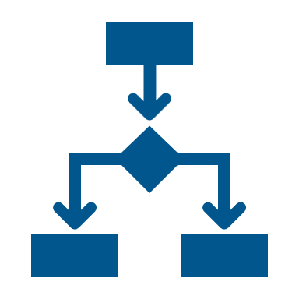
Resiliency: Challenges & Impact
Impact
Absence of E2E single observability platform and historical data
Root cause detection tends as a time-intensive process
Degraded customer experience
Inconsistent tools and automation strategy leads to high toil, inefficient tool utilization
Higher spend on monitoring tools
Reactive approach rather than a Proactive approach
Challenges
Lack of visibility for business to plan
changes and features
Support team on firefighting mode
Inefficient skillset and limited time to implement automation and reduce toil
Lower than expected Resiliency and
Scalability for applications
© 2024 NTT DATA Inc.
Notes:
Vikram
NTT DATA has a strong SRE practice supporting resiliency for organizations.
We follow a tool-agnostic approach and can help the organization in achieving the Target Operating Model where data is collated from all monitoring sources to be used in Dashboards and AIOps.
We help organizations transform SRE operations through short-term, long-term initiatives and a roadmap to have a target state where SRE is provided as a service to bank consumers like business value streams and engineering.
Defining and curating customized dashboards related to SLOs and Error Budgets.
We have been supporting various banks globally in the geographies of Europe, Ireland and US.
NTT DATA’s Splunk Capabilities are being powered by our Splunk Centre of Excellence (CoE). We have a robust CoE orchestrated by our strong competency, experience, global best practices, domain and business knowledge, value added services.
Our resources possess Splunk Expertise to deliver success:
NTT DATA Splunk SMEs have been a part of SplunkTrust since the year 2020, which is a Global community where Splunk recognizes a handful of individuals annually.
We possess relevant experience and capabilities to navigate through Splunk’s three operational towers: Architecture, Administration and ITSI (IT Service Intelligence)

Slide 8


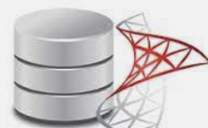

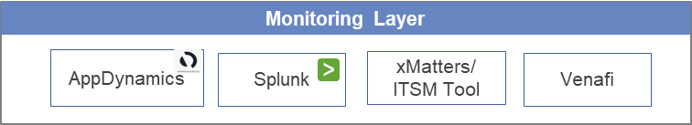



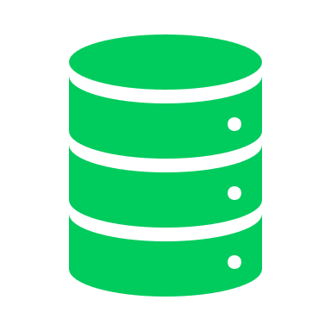

Tools, Automation & E2E Observability
Current State
Target State
Efficient Tools Configuration & Monitoring
Correlation of Data
InfluxDB
MongoDB
MSSQL
Centralised DB
Data collated from all the monitoring sources to use in Dashboards and AIOps
End to End Observability
Bespoke Automation
Data Analytics
Overarching AIOps
Infra Layer
App Layer
OTEL
- C
Kubernetes
Monoliths
Single Pane of glass view
Runbooks Automation
Historical Trend Analytics
Self Healing
Cloud
Mainframe
User/ Persona Layer
Configuration as a Code
Predictive Maintenance
Future Projections
VM
Serverless
Defined SLI, SLO, Error budgets
Certificate Renewals
Bare metal
Microservices
Failure Hotspots Identification
Use Case
Benefits for Bank
Reactive approach
Inefficient implementation of monitoring tools
No single observability platform
Historical alerts & incident data not available as rich monitoring data not shared outside monitoring tools and is discarded within a few weeks.
Automation strategy non-existent. Most activities are manual
Improved End-to-End Customer Experience
Efficient use of monitoring tools
Easy retrievable data from centralized DB for audit trials, Risk and compliance
© 2024 NTT DATA Inc.
Notes:
Vikram
NTT DATA has a strong SRE practice supporting resiliency for organizations.
We follow a tool-agnostic approach and can help the organization in achieving the Target Operating Model where data is collated from all monitoring sources to be used in Dashboards and AIOps.
We help organizations transform SRE operations through short-term, long-term initiatives and a roadmap to have a target state where SRE is provided as a service to bank consumers like business value streams and engineering.
Defining and curating customized dashboards related to SLOs and Error Budgets.
We have been supporting various banks globally in the geographies of Europe, Ireland and US.
NTT DATA’s Splunk Capabilities are being powered by our Splunk Centre of Excellence (CoE). We have a robust CoE orchestrated by our strong competency, experience, global best practices, domain and business knowledge, value added services.
Our resources possess Splunk Expertise to deliver success:
NTT DATA Splunk SMEs have been a part of SplunkTrust since the year 2020, which is a Global community where Splunk recognizes a handful of individuals annually.
We possess relevant experience and capabilities to navigate through Splunk’s three operational towers: Architecture, Administration and ITSI (IT Service Intelligence)

Slide 9
Overall Approach - How we do it
Discover & Design
Build & Implement
Run & Manage
Requirements Gathering
Assessment & Design
Data Source Integration
Signaling Specification
Platform Configuration
Process Mapping & Implementation
SRE + Business
SLO/SLI Definitions
Error Budget Policies
Signal Selection & Thresholds
Stakeholder Interviews
Service Inventory
Current State Analysis
Signal Validation
Compliance Validation
Process Validation
Team Structure Analysis
Gap Analysis
Data integration
Signaling
Dashboard & Platform config
Process Mapping
Recommendations and Standards for
Prometheus
AppDynamics
Dynatrace
OpenTelemetry Collectors
Observability tools from AWS e.g. Cloud watch, X-ray etc
Other Observability tools
Other Data Sources as required
Recommendations and Standards for
Normalisation
Logging Levels
Security Protocols
Synthetic Metrics
Metrics Traces & logs
KPI & threshold development
Dashboard configuration
Implement and tune anomaly detection sensitivity levels
Implement noise reduction
Review and correct variable log levels
Recommend signaling collection for value stream telemetry gaps
Event Handling
Continuous Improvement
Incident Response
Unified Observability dashboards
Continuous Compliance for FCA
Platform Management
Managed telemetry integration, analytics and automation
for bank’s Infra teams (Splunk ITSI)
For Application Teams (ServiceNow)
Continuous Improvement
One Customer Journey
Design
Build & Implement
Repeatable process for every customer journey
Assessment & Design
Data Source Integration
Signaling Specification
Platform Configuration
Process Mapping & Implementation
© 2024 NTT DATA Inc.
Notes:
Taxonomy development for SLO/SLI/EB – e.g. payments conclusion in 4 min. how do you track that.

Slide 10
Client Success Stories
© 2024 NTT DATA Inc.

Slide 11
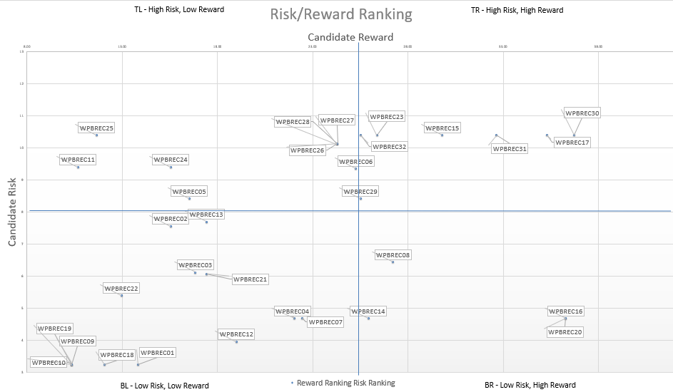

Case Study 1- NTT DATA’s SRE Accelerators
Risk – Reward Matrix
Baseline SRE Metrics
SLI, SLO and Error Budget are crucial components of SRE. They help quantify the performance and reliability of services and set expectations for users and stakeholders. We have defined templates for the metrics (VALET) that can be used for a quick baseline setup.
V=Volume;
A=Availability;
L=Latency;
E=Errors;
T=Tickets
Accelerators
Quick Win Automations
SPoG & Integration
Splunk Configuration Changes
Pipeline that can be integrated to enable a configuration-as-code approach for managing Splunk settings. This streamlines the process of updating and maintaining Splunk configurations.
Certificate Renewal –
Microservice that automates the renewal of certificates hosted on Venafi. The service ensures the timely renewal of certificates and automatically pushes updated certificates to the relevant application repositories.
Single Plane of Glass
Comprehensive observability strategy is necessary for effective SRE. We have predefined dashboards in Grafana (an open-source tool) for SRE that can be reused by importing JSON files
Integration Scripts
We have developed tool-agnostic Python scripts that facilitate connections to various sources, such as Splunk, AppDynamics, InfluxDB, and more, enabling the retrieval of key application performance metrics and data transmission to databases.
© 2024 NTT DATA Inc.

Slide 12

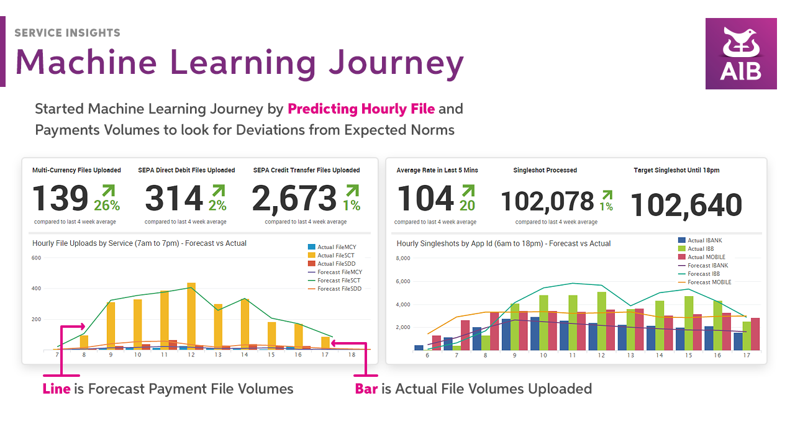
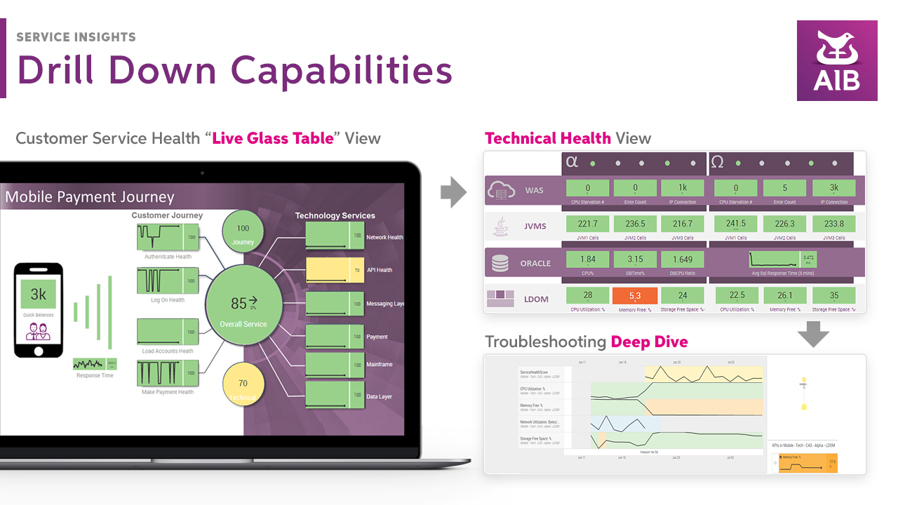
Success Story: Leading Irish Bank– Splunk Implementation and Support
Vision of the bank was to transform data into action. Real Time single pane dashboard of 360 Health View of Business, App & Infrastructure across enterprise was implemented.
Business Need
Solution
Outcome
Inability to proactively or predictively maintain real time or trend-based insights on quality of service and experience across banks key customer journeys.
Reduce Operational , Transformational, and regulatory risk
E2E Integrity for Payments
Improved SLA Performance & Reduced Incidents
360 Health View of Business, App & Infra
Established dedicated Splunk COE – Design, development & support
Advised bank on deciding key KPIs for Real Time Monitoring
Helped bank in creating workflows in Splunk tool and AI (Predictive Analytics and NLP)
Helped bank in implementation and support of :
Proactive monitoring of Mobile App using Splunk ITSI
Predictive Business Service Monitoring
Automated Service Intelligence Platform
Bank’s Service Insight platform is a leader among global banks and was shortlisted for Award for Besr Application of AI in Large Enterprise
Improved customer experience in measuring extracting
Bank become proactive and predictive
Up to 30% reduction in incidents & MTTR
Implementation of Service insights platform helped bank in reducing regulatory, transformational and operation risk
© 2024 NTT DATA Inc.
Notes:
Prep Questionnaire-> basis which we will chart out current assessment strategy- types of payments, volumes, historic incident data,
What is Out of Scope:
Detailed Transition Plan

Slide 13


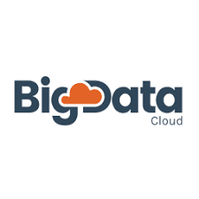











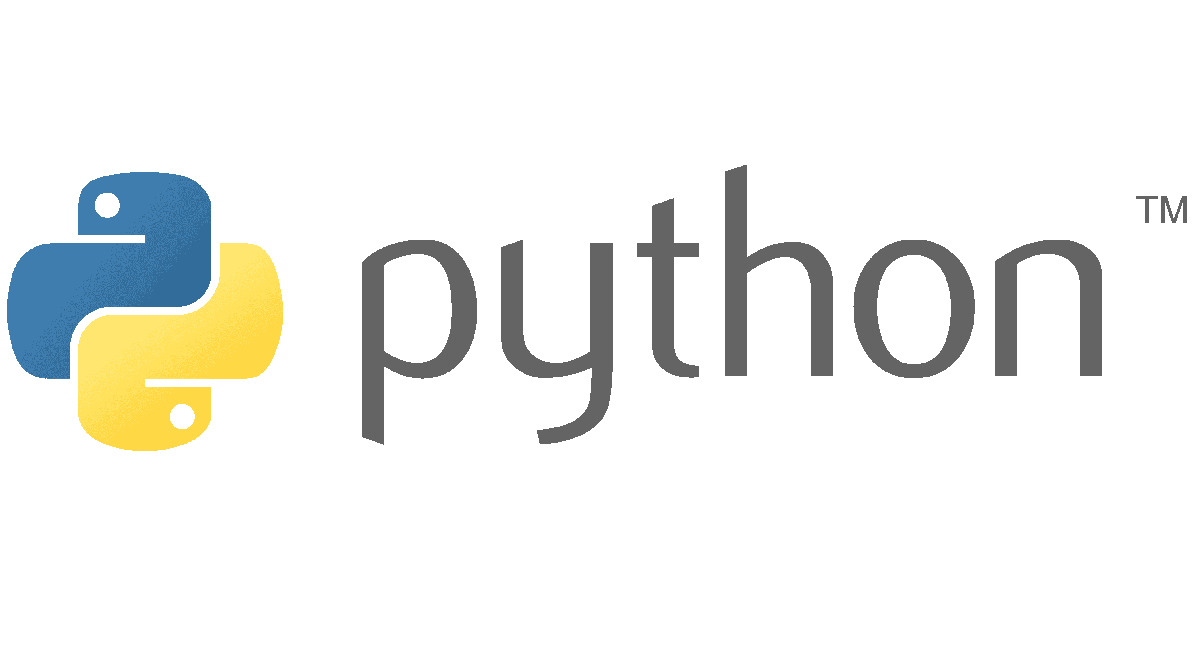

Case Study 2- Leading Global Bank
Current State Architecture has been derived for five applications (GPE, WOLF, PDP, POL and GMG) based on detailed analysis. Considering these 5 apps as a true sample, target state Architecture is curated for all GPS applications bearing in mind they will have similar tech stack and monitoring
App 1
App 2
App 3
App 4
App 5
Infra Layer
VM
VM
AWS
Non-IKP Apps
IKP Apps
Apps Layer
C++
Microservices
Current State
Target State
What is Changing?
Challenges with Patrol
IKP Apps
Non-IKP
IKP Apps
Non-IKP
❶
Historical data not available for trend analysis
CICD workflow can’t be associated, no drift prevention
Fetching & review of alert parameters is cumbersome
No capability for data sharing from AppD
No dashboard capability
Process
Process monitoring to be switched from Patrol to AppDynamics
Log monitoring to be switched from Patrol to Splunk
One dashboard tool (Splunk ITSI) for all applications with consolidated data from all monitoring tools.
Automation use cases to be implemented with improved tool utilisation, xMatters to be leveraged for self-healing.
❶
Log
❷
❷
Monitoring Layer
❸
Infra
Dashboards
Service Health
User/ Persona Layers
❹
App 1
AppD Dashboard
Operations
Engineering
Support
❸
Log Watcher Tool
SPLUNK ITSI
IDRS – DC monitoring
Unified Dashboards
2024
After 2024
App 2
Monitoring setup in Splunk/AppD for Tier 0 services
Post approval from ITSOs and App owners, incident creation in SNOW will be migrated to Splunk/AppD from PATROL
Incident Generation via SNOW through Splunk/AppD
Post Splunk/AppD alerting approvals for working & coverage, PATROL alert monitoring to be switched off
App 3
IKP - Grafana
Central Reference Data
In-house Tools
❹
Automation
Alert setup continues in PATROL
© 2024 NTT DATA Inc.
Notes:
Vikram
NTT DATA has an array of accelerators such as:
- Defined templates for Error Budgets and SLIs/SLOs
- Reusable predefined dashboard
- Tool agnostic Python scripts

Slide 14
Customer Impact Centre
© 2024 NTT DATA Inc.

Slide 15

What We Do as Part of Analysis
Customer Journey X (Dependent Upon Full Stack Observability)
NTT DATA will use the existing knowledge base within the bank to understand E2E customer journey and the underlying technology components (application and infrastructure) that enable the journey
NTT DATA will work with bank’s teams to establish/validate or create meaningful SLO’s which would indicate the normal “good” performance of the applications across the customer journey and service chain maps.
NTT DATA will identify any gaps in signaling (tracing, logging and metrics) for technology components.
NTT DATA will work with the required bank’s teams to define standards for signaling.
NTT DATA will provide recommendations to bank’s teams to normalise the telemetry data (standards).
NTT DATA will integrate (recommend) the available signaling, event, metric and logging data into the appropriate Service Level Indicators (SLI’s) as per the outlined solution
NTT DATA will provide dashboarding recommendations to bank’s administrators to visualize end-to-end observability of the user journey, with a top-level focus of an outage or performance issue that is critical to the normal function of that user journey or feeding an upstream or downstream user journey.
NTT DATA will provide the requirements of dashboarding of traces and trace spans to allow identification of where the technology components are failing.
© 2024 NTT DATA Inc.
Notes:
Customer Impact Center

Slide 16

SRE Operations within CIC
What will be the role of SRE’s staffing the CIC
Major incident response
Detect, react and perform fault isolation for major impacts to applications across GBGF’s and value streams
Provide management alert for end-user affecting faults or performance issues
Engage MIM team and share triage analysis and potential resolution, remain engaged to provide signaling information to resolvers
Remain engaged and confirm resolution
Predictive fault isolation of component (through error budget creep) across customer journey
Conduct blameless postmortems to identify “Why” a fault occurred
Provide analysis to build automation to prevent faults of this type
Understand changes to application ecosystems and make SLO & observability recommendations for additional or altered application or ecosystem changes
Document all operational procedures
© 2024 NTT DATA Inc.

Slide 17


Bringing it to life
Customer Journey - High-value Payment
Channels
Orchestration Layer
Payments Engine
Sanctions
Application
Core Banking
Build
Application
Network
Infrastructure
Middleware
Compute
Application
Network
Infrastructure
Middleware
Compute
Application
Network
Infrastructure
Middleware
Compute
Application
Network
Infrastructure
Middleware
Compute
Application
Network
Infrastructure
Middleware
Compute
Establish SLOs
Define Signaling Standards
Tech Stack
Tech Stack
Tech Stack
Tech Stack
Tech Stack
Normalize Telemetry Data
Recommend for missing Telemetry
Output
Integrated Signaling into SLIs
E2E tracing across journeys
Detailed Telemetry to support drill-down
Consumed by
Automation
Blameless Postmortem
CIC Team
© 2024 NTT DATA Inc.
Communication
Fault Isolation

Slide 19

Bringing it to life
Customer Journey - High-value Payment
Channels
Orchestration Layer
Payments Engine
Sanctions
Application
Core Banking
Build
Application
Network
Infrastructure
Middleware
Compute
Application
Network
Infrastructure
Middleware
Compute
Application
Network
Infrastructure
Middleware
Compute
Application
Network
Infrastructure
Middleware
Compute
Application
Network
Infrastructure
Middleware
Compute
Establish SLOs
Define Signaling Standards
Tech Stack
Tech Stack
Tech Stack
Tech Stack
Tech Stack
Normalize Telemetry Data
Recommend for missing Telemetry
Output
Integrated Signaling into SLIs
E2E tracing across journeys
Detailed Telemetry to support drill-down
Consumed by
Automation
Blameless Postmortem
CIC Team
Communication
Fault Isolation

